Slide 1
Hate Speech and Hate Network Detection
By Jeetendra Joshi
WARNING: Presentation includes profanity due to the nature of the project.

Slide 2
Motivation
Social media is great but we all know there is a fundamental problem. Everyone loves how easy it is to setup and use but what happens when the wrong person/people/group manage to influence many by spreading hateful thoughts?
We saw in October last year that "Facebook has been unwilling to accept even little slivers of profit being sacrificed for safety"^{[1]}
I wanted to see whether I could do something about it
Sources: https://www.bbc.co.uk/news/technology-59038506

Slide 3
Problems with Hate Speech Detection
Hate Speech is large and varied
Cannot be done manually – We cannot monitor every social media post + we as humans have bias
Only detects one person at a time
Notes:
REMEMBERWEIGHT DECAY == 0. FIND A REASON WHY

Slide 4
Utilised Models
K-NNs
NBSVMs
BiGRUs
Transformers

Slide 5
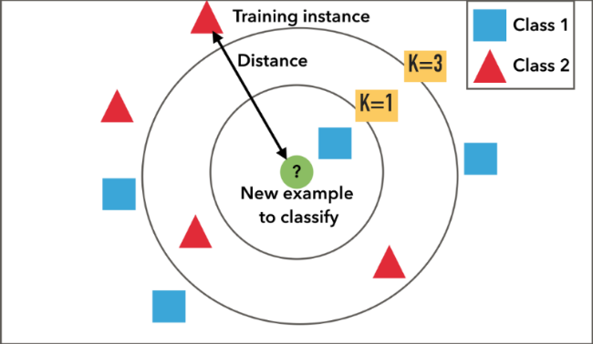
K-NNs
Supervised Learning Algorithm – Data is prelabelled
Each sample looks at its K closest neighbours and its class is determined by the majority class of its K neighbours

Slide 6
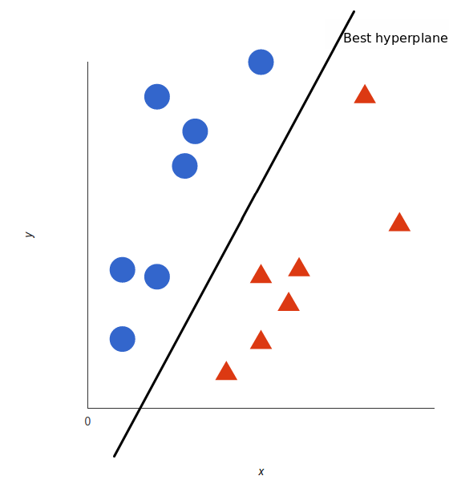
NBSVMs
Combines a support vector machine with naïve bayes log-count ratios.
Naïve Bayes log-count ratios – probability a word appears in positive class versus negative class instead of word embeddings

Slide 7
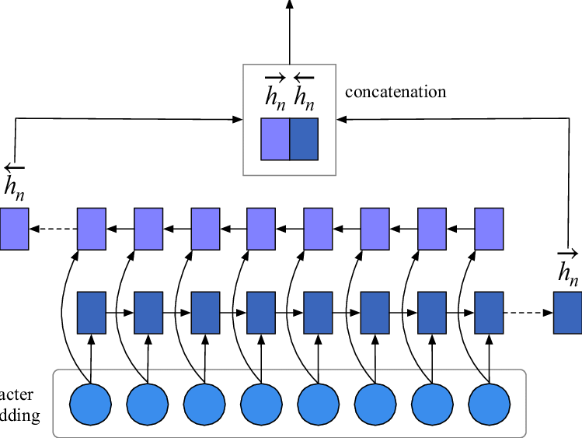
BiGRUs
Model that consists of two GRUs, one taking input in forward direction and other in a backwards direction
A GRU is similar to an RNN, but also contains an update and reset gate which determine the information passed to the output.
It looks at multiple input words to determine the output of the network.

Slide 8
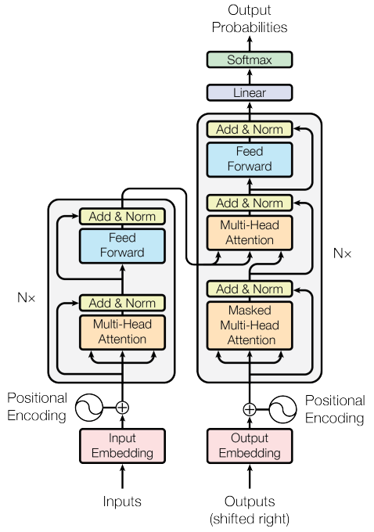
Transformers
Encoder- Decoder Architecture
Uses attention to denote key parts of an input sequence
Both position and context of a given input when outputting probability of an output

Slide 9
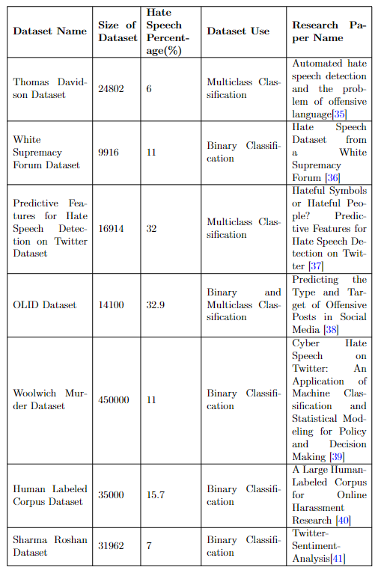
Dataset Collection
Looked at various publicly available datasets, mainly reading various papers and looking at sites such as hatespeechdata.com
Concluded on two datasets, Thomas Davidson dataset and Sharma Roshan Dataset

Slide 10
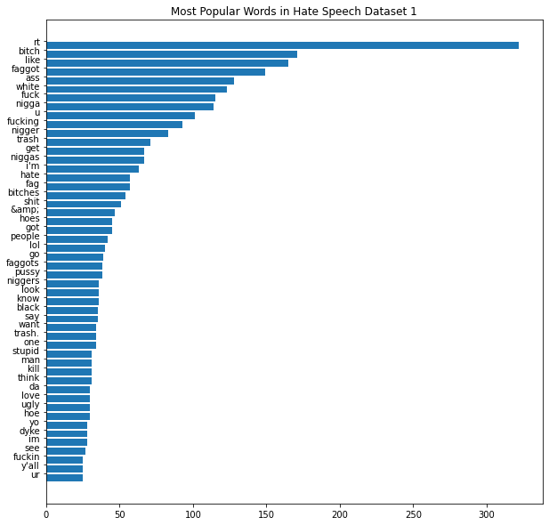
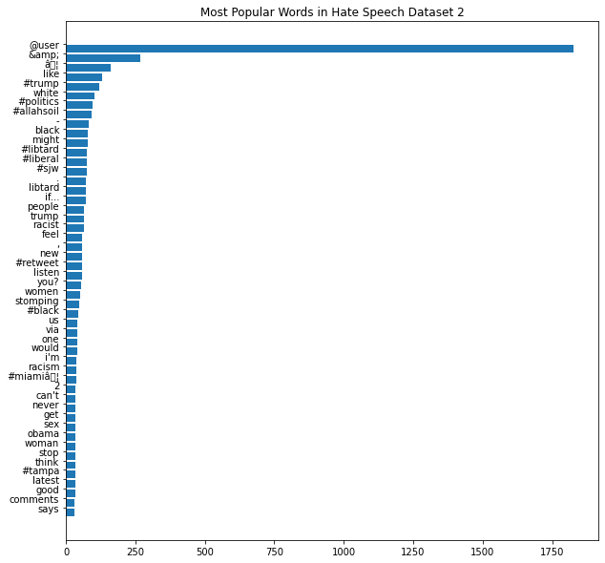
Text Analysis
Observed patterns in the data, more specifically each class
Found that certain terms were common in hate speech such as “@USER” tags and URLs.
Also, lots of profanity was found in hate speech terms (as expected)

Slide 11
Preprocessing
Before model development, the text was preprocessed to ensure that only useful data was input to the models.
This meant that the models would be learning the best possible information
Information Removed -> Punctuation other than exclamation points, question marks, commas and full stops
Information altered-> URLs and specific user tokens
Thomas Davidson set was altered from multi-class to binary classification

Slide 12
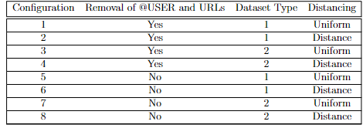
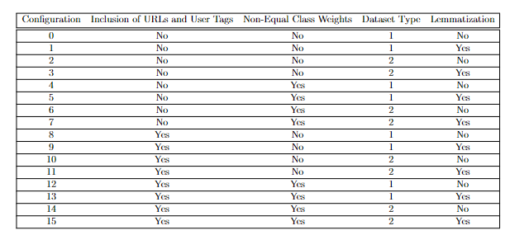
Configurations
KNN’s
NBSVM’s, BiGRU’s and Transformers

Slide 13
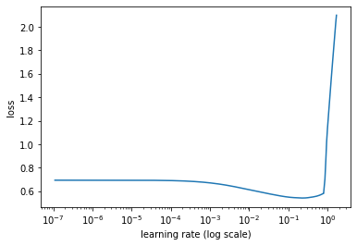
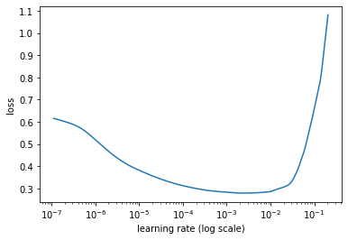
Model Training
Each model was trained with a triangular learning rate policy
Each model was also assigned a different learning rate determine by the lr_find function in K-Train
They were determined by looking at the value that resulted in the largest negative gradient

Slide 14
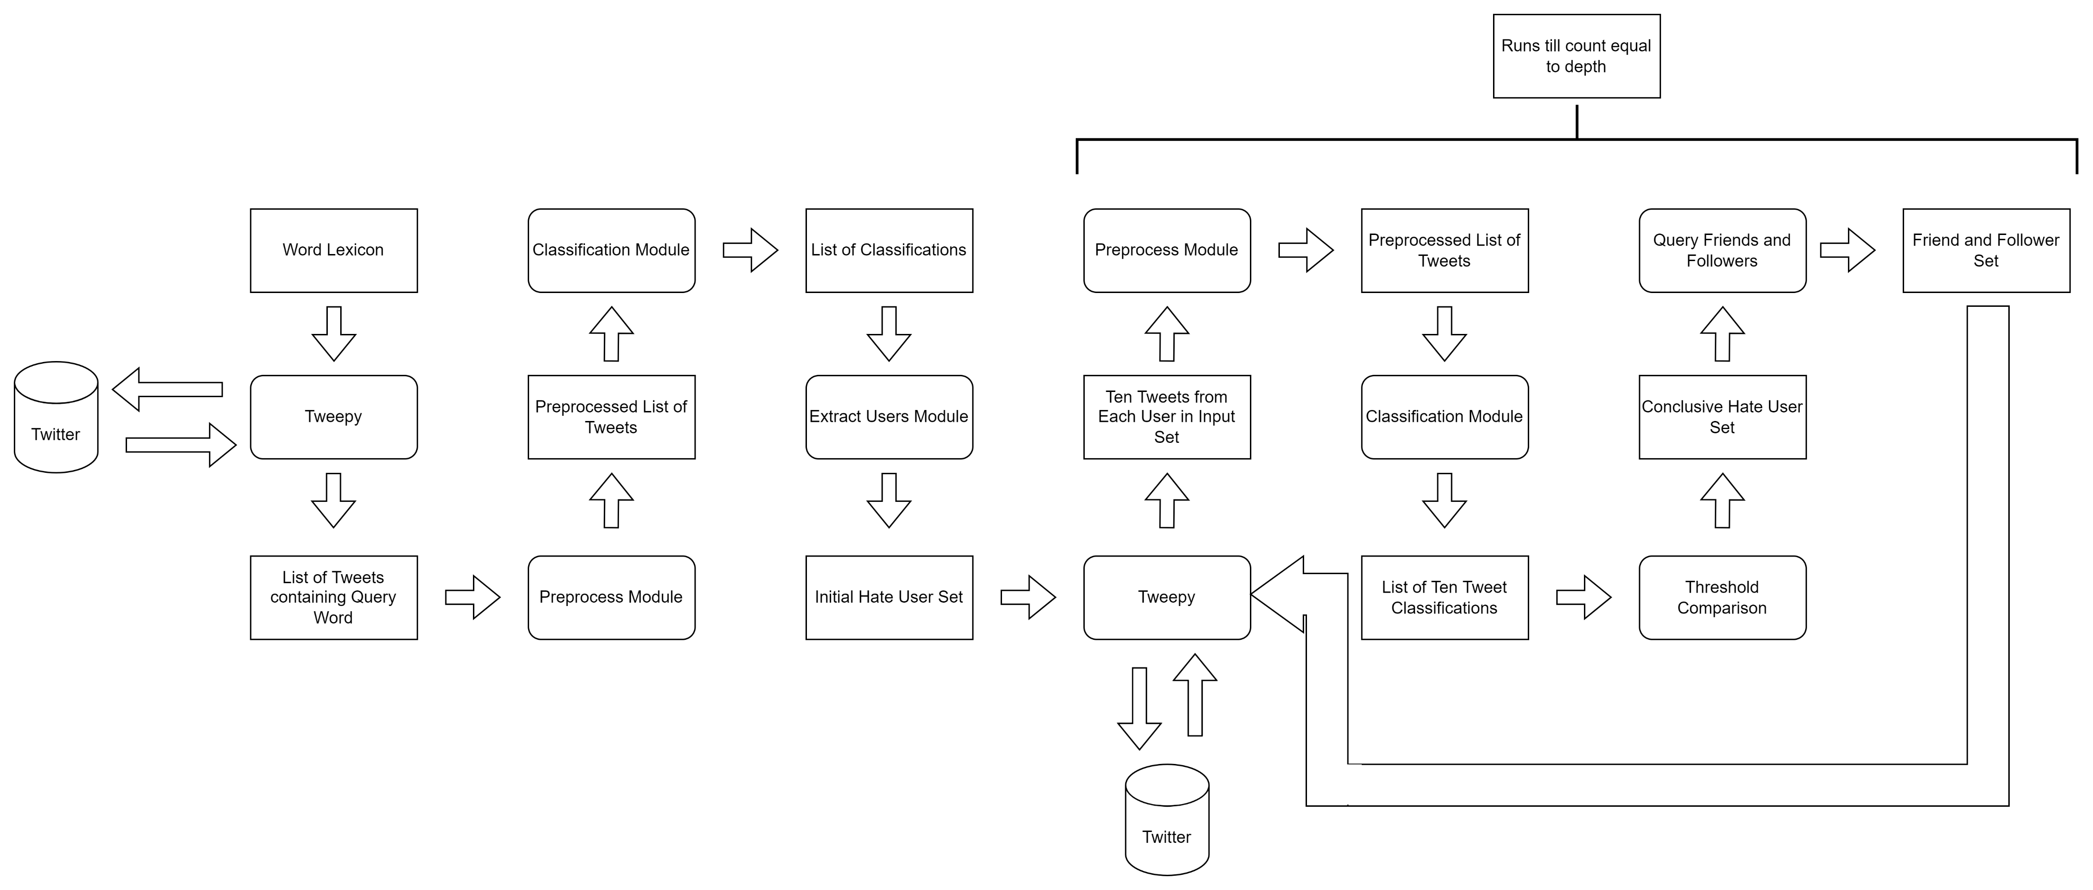
Hate Network Algorithm

Slide 15
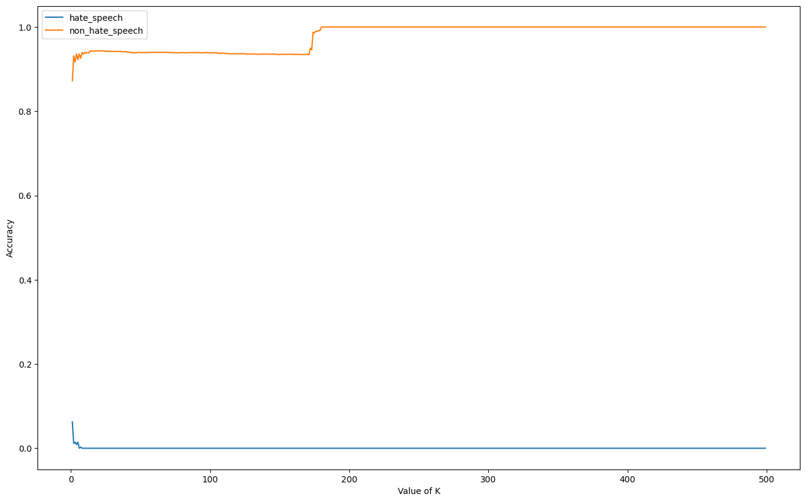
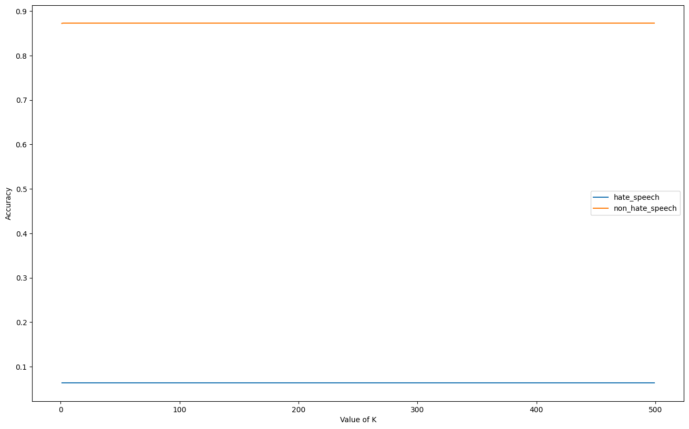
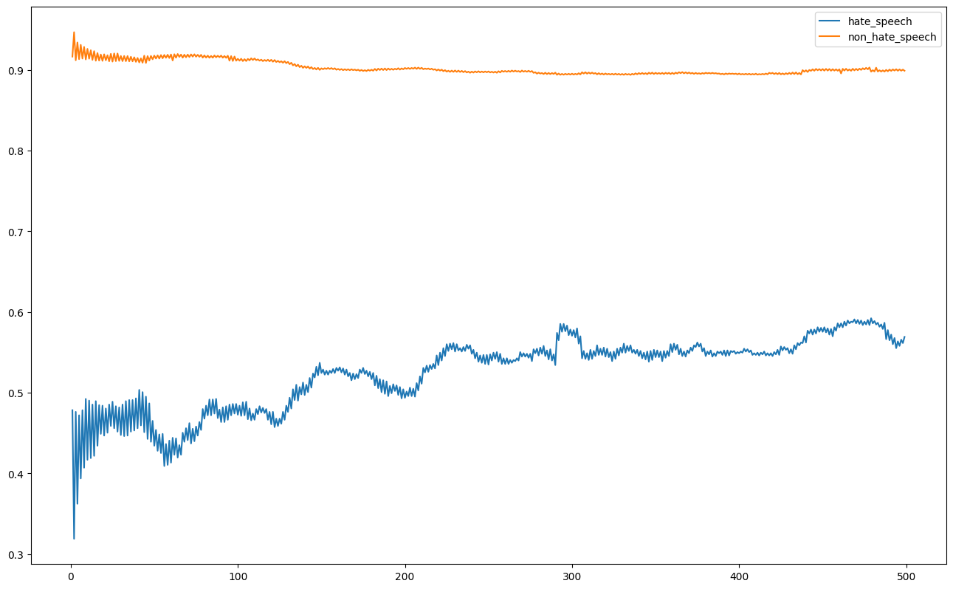
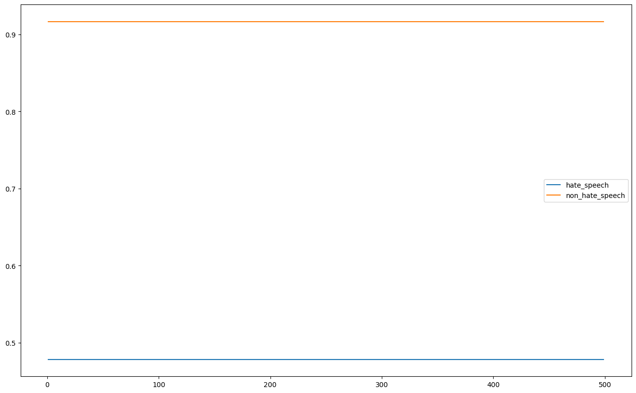
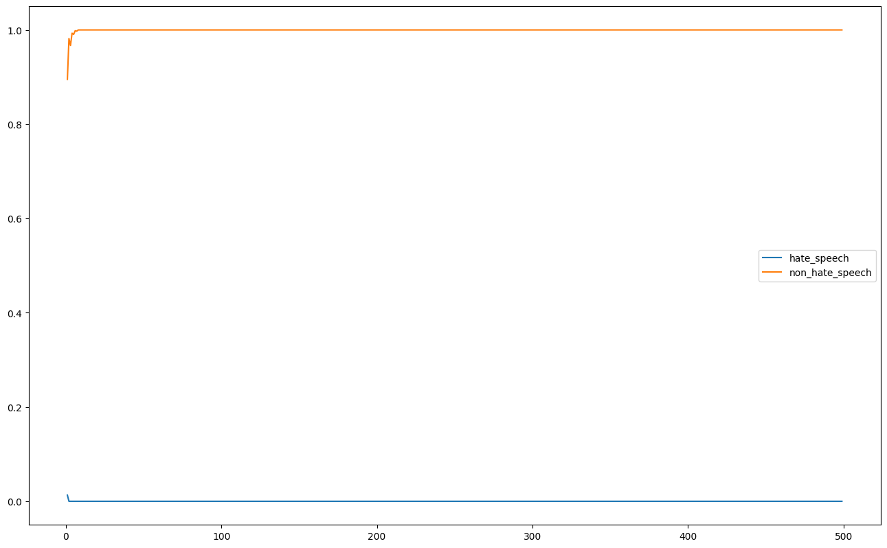
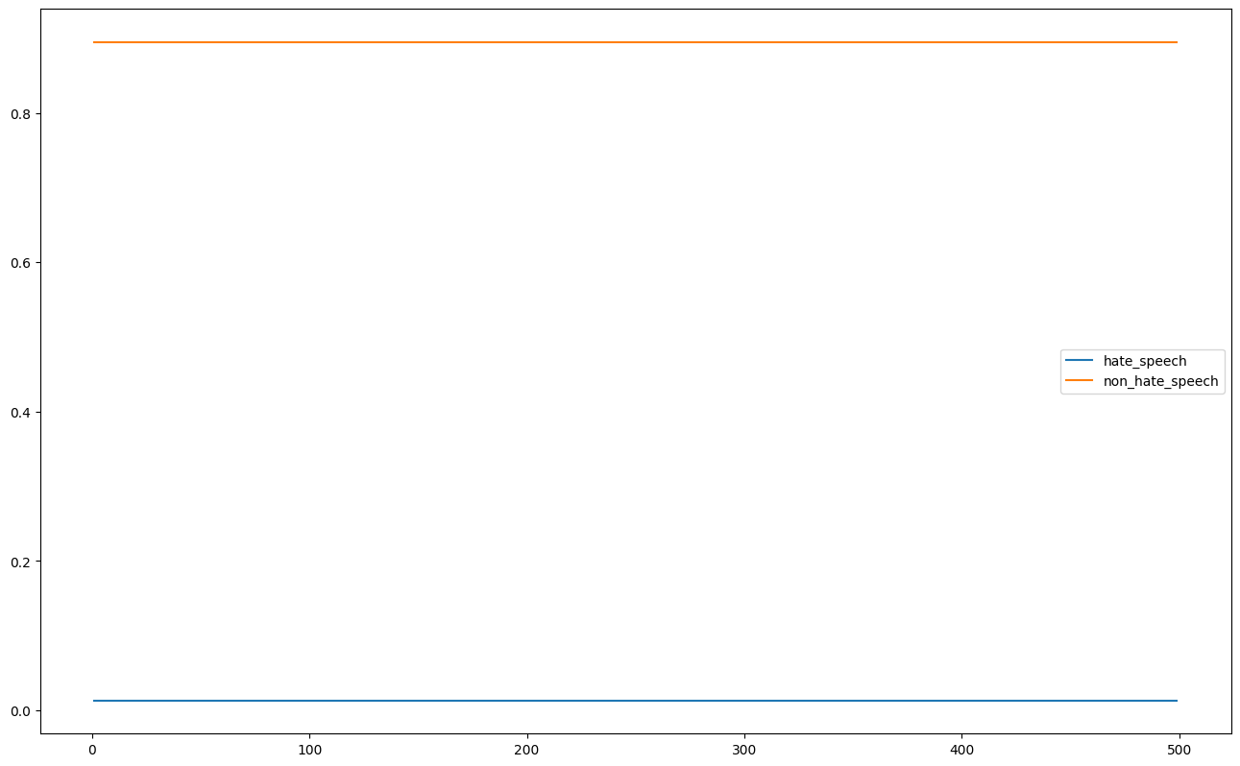
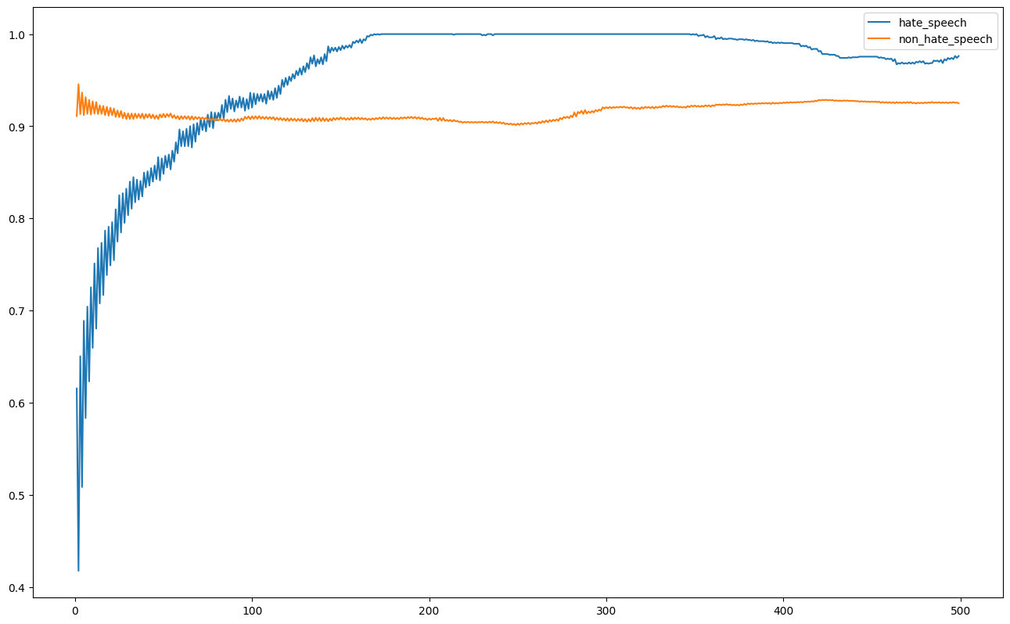
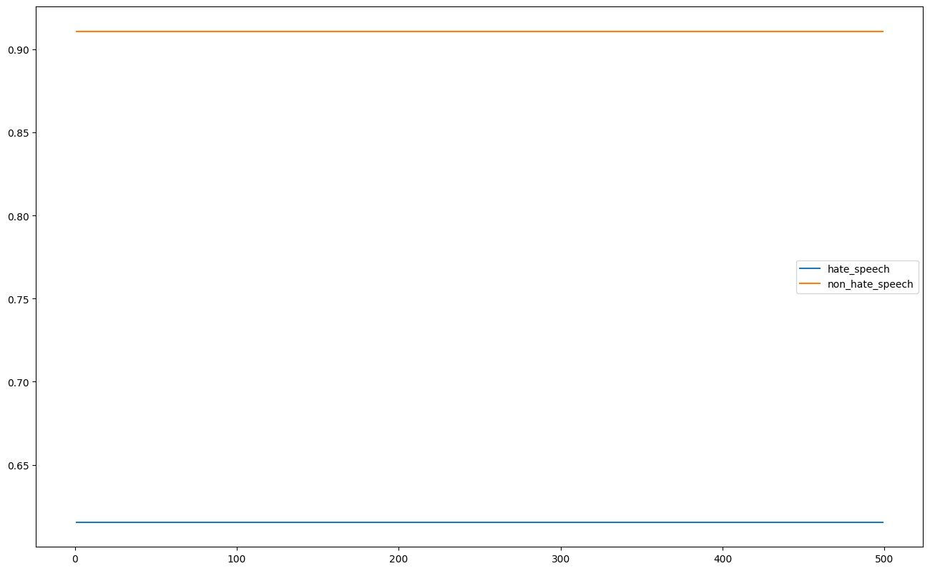
Testing – K-NNs
1 2
3 4
5 6
7 8

Slide 16
K-NN Key Takeaways
Generally most configurations showed that it there was no change in classification accuracy as K increased except for configurations 3 and 7 implying a relation between uniform distancing and a balanced dataset regardless of URLs and USERs
Very difficult to use a K-NN and only frequencies of words to distinguish hate and non-hate speech instances

Slide 17
Testing – DL Models
All the results collated in the form: True Positives| True Negatives| False Positives|False Negatives
Not very useful so they were converted to metrics resulting in tables

Slide 18
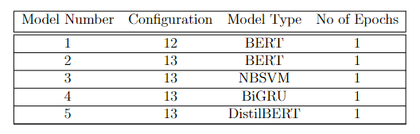
DL Methods Key Takeaways
MODEL DOESN’T MATTER -> All models performed similarly and the dependency was not on the model used, but the configuration used
The best configurations were configurations 4 , 5 , 12 and 13.
They all performed well at the PERFORMANCE metric: (Hate Speech Accuracy + Non-Hate Speech Accuracy) / 2
The models on the right were used as an ensemble and further tested versus state-of-the-art models

Slide 19
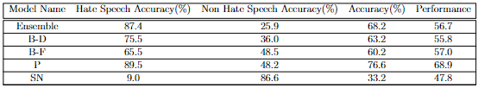
Our Model vs State-of-The-Art

Slide 20
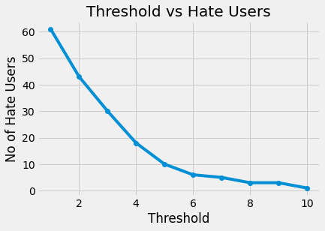
Testing – Thresholding for Hate Network Detection
As mentioned previously: we have a threshold we need to determine
We query every word in our lexicon and classify the tweets from every user to get an initial hate set -> 63 people
We look at each of those users’ past ten tweets and classify each of them applying a threshold from 1 to 10
We get a band at the bottom where there isn’t much change like an elbow plot. The value of 7 was chosen for this investigation

Slide 21
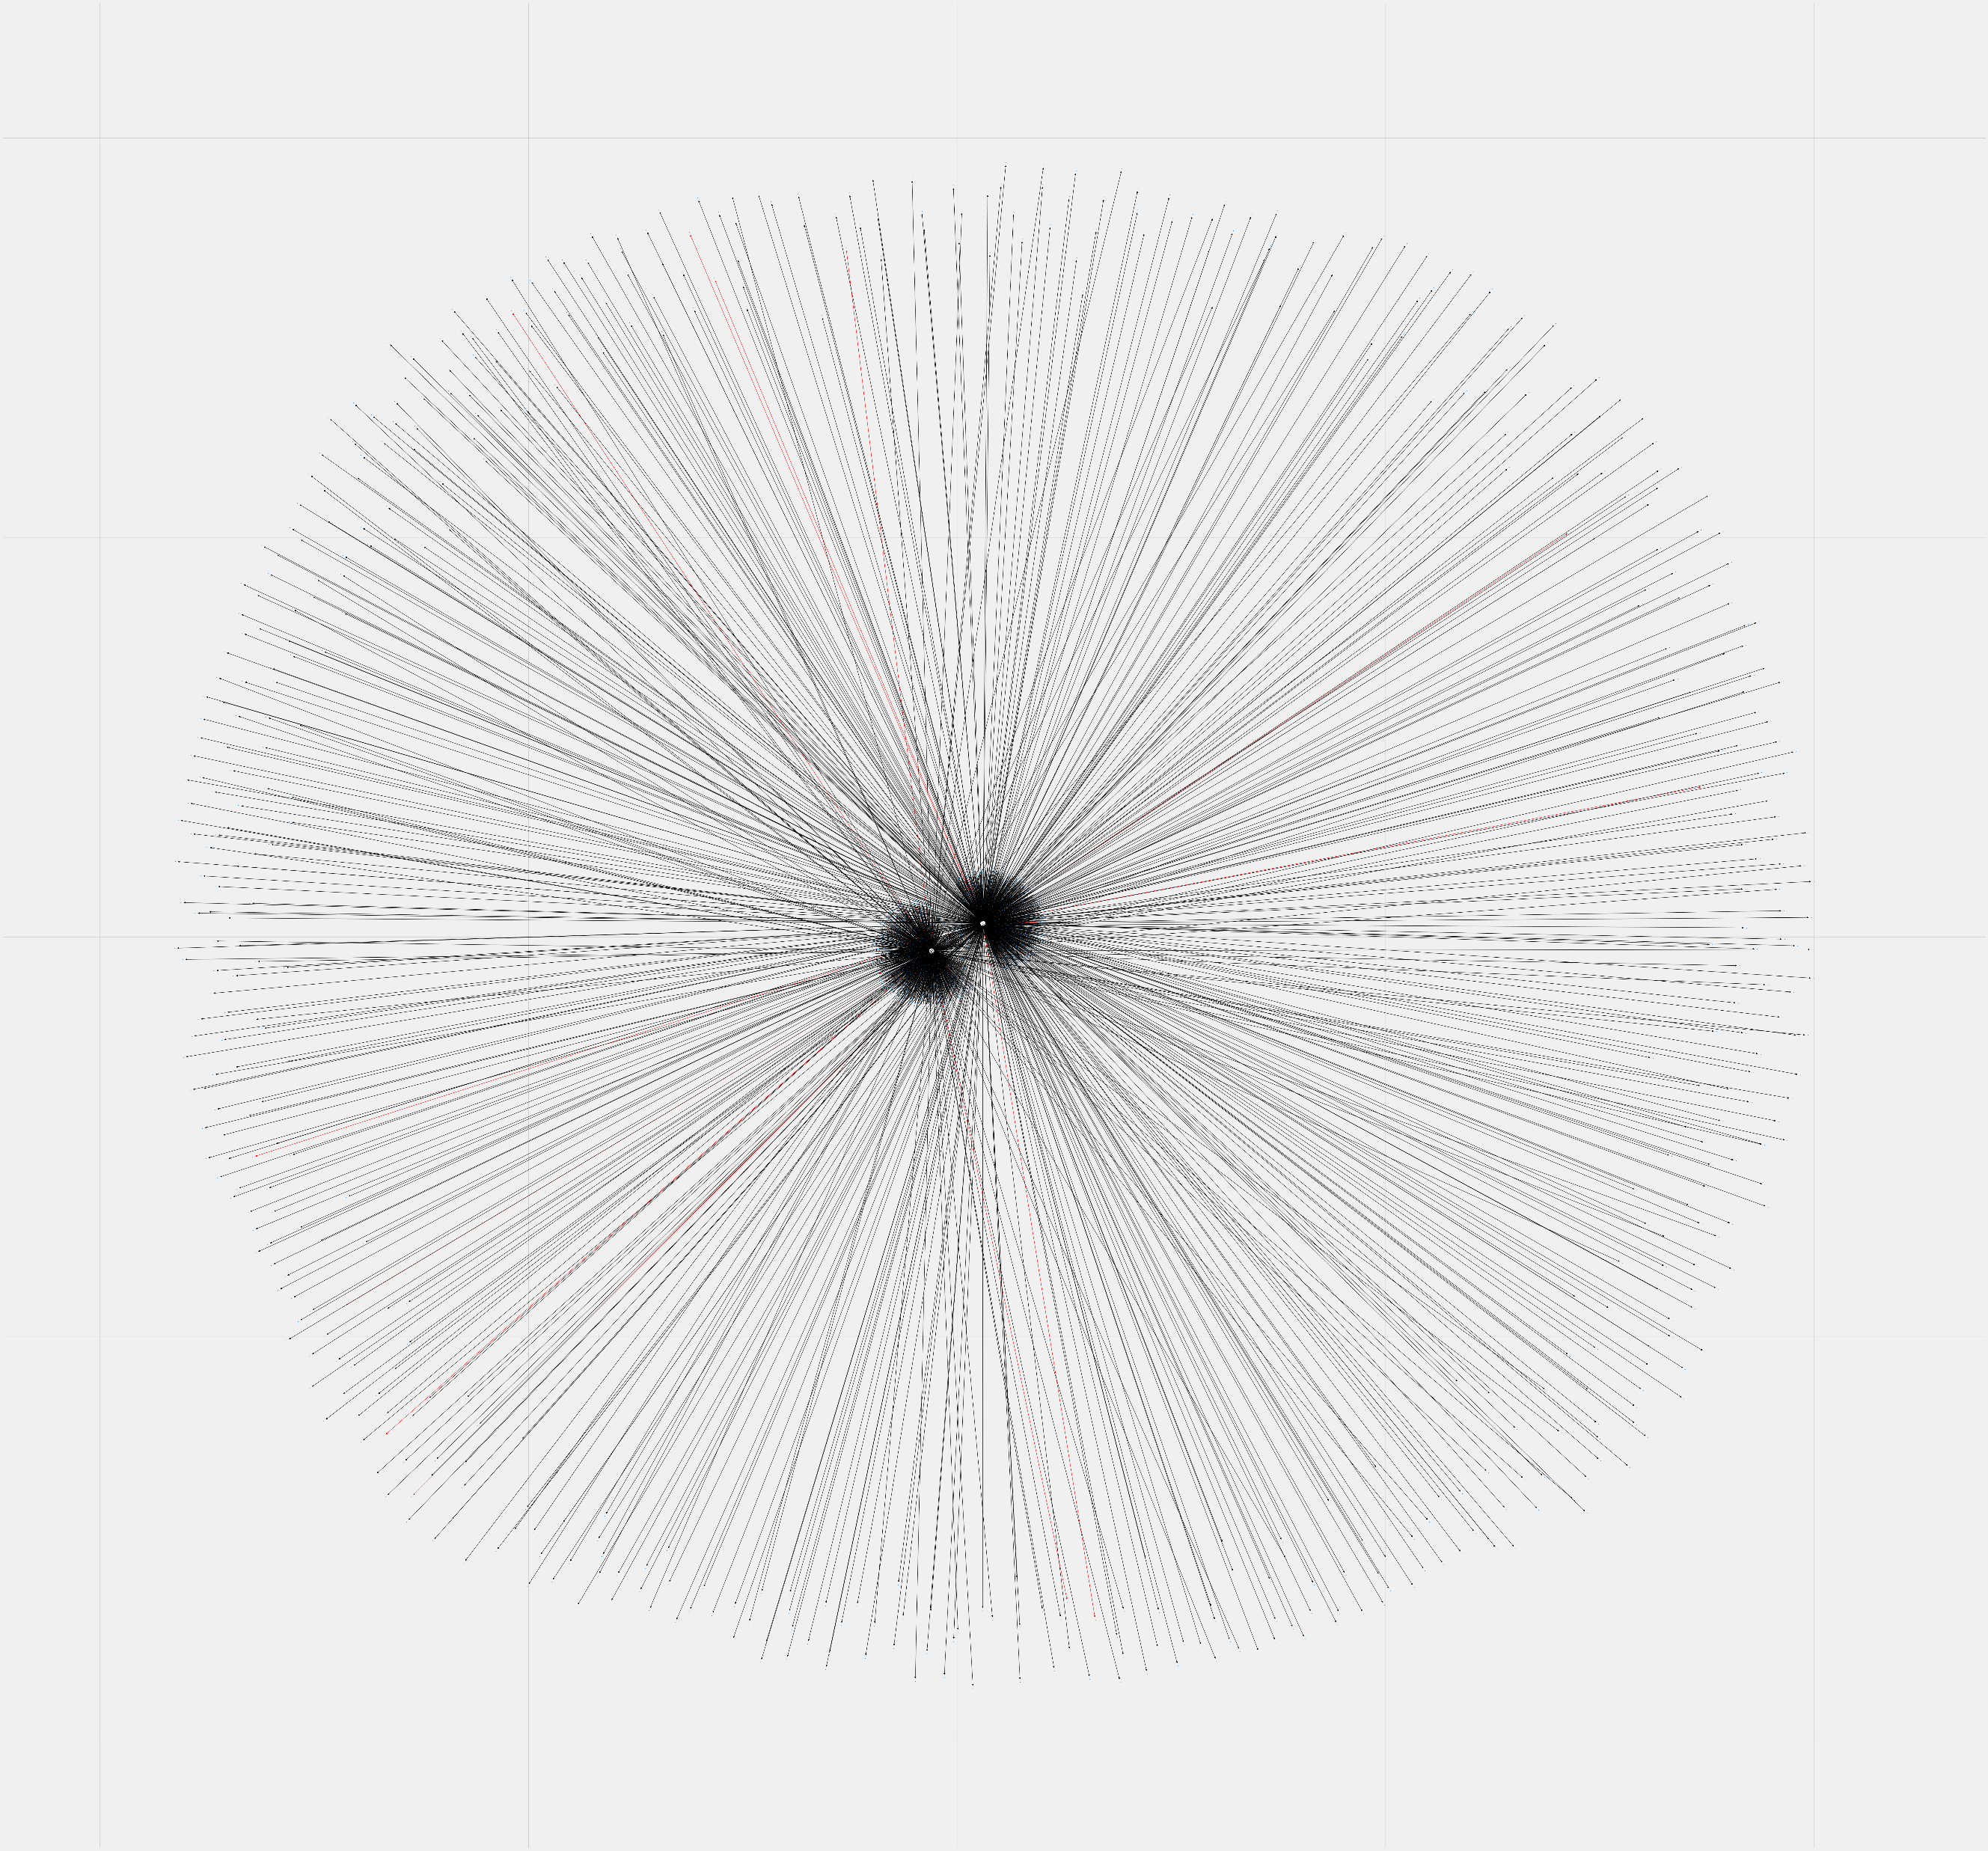
Testing – Hate Network Detection
With this, you get really cool images like on the right ->
This is a hate network detected by the algorithm. At the end of each line is a user. Red lines are connections between hate users.
Problem -> This only looks as 2 initial hate users, doesn’t go further than their friends and took 3.5 hours to generate

Slide 22
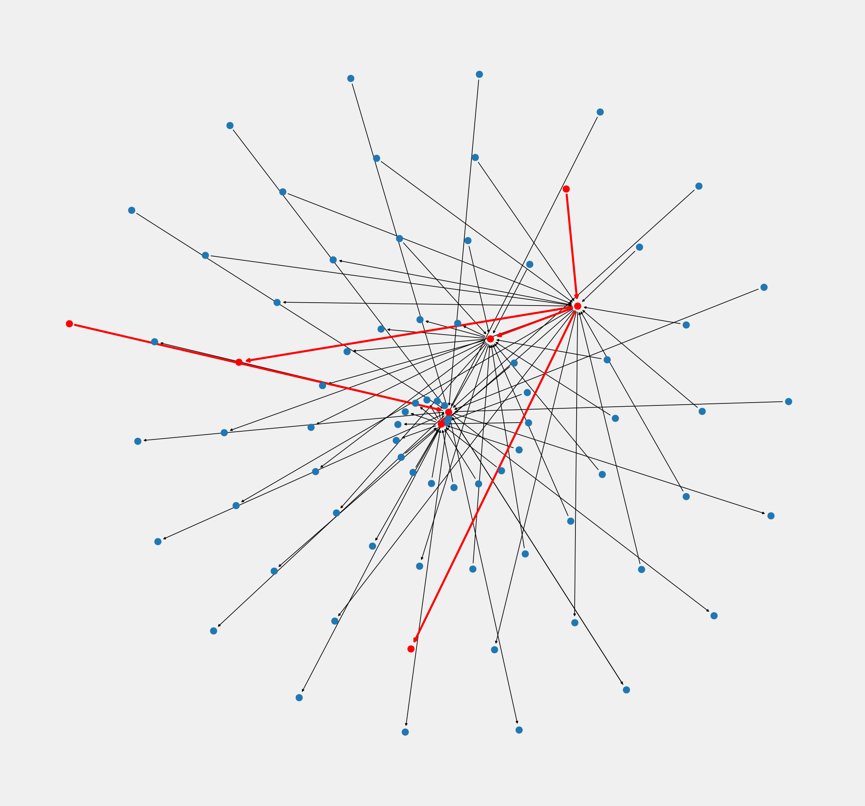
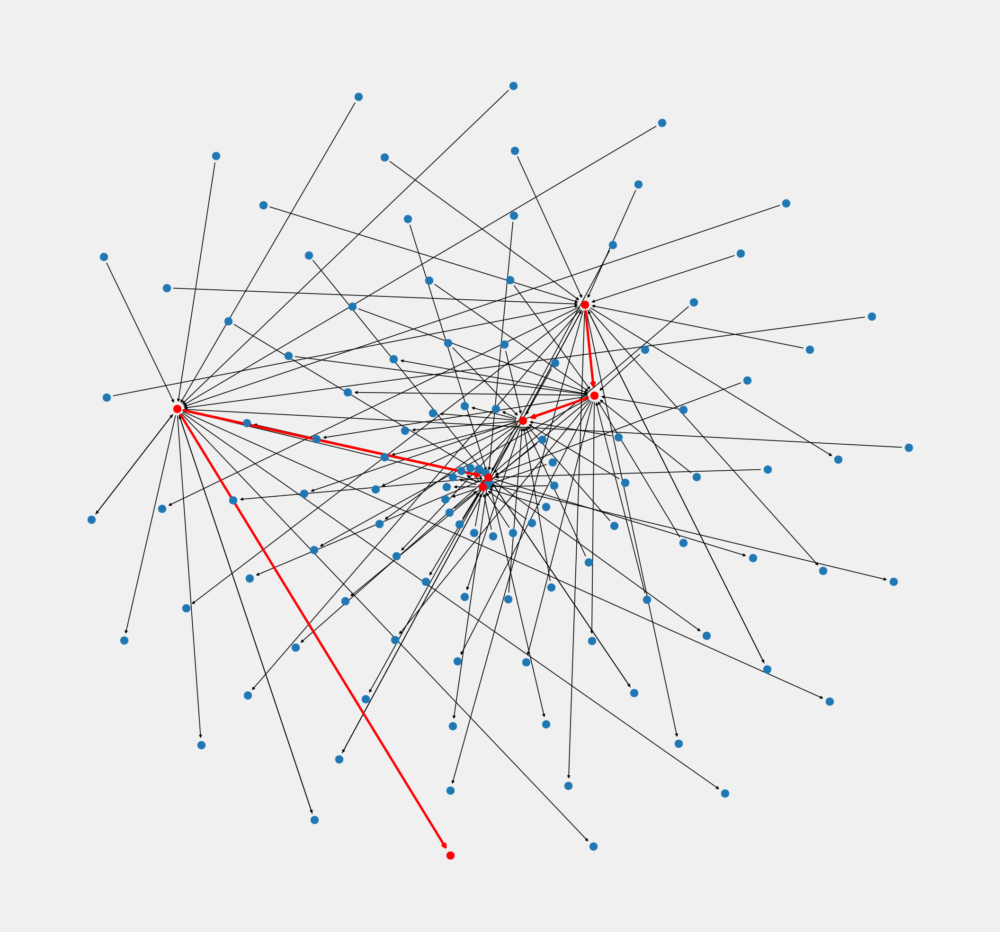
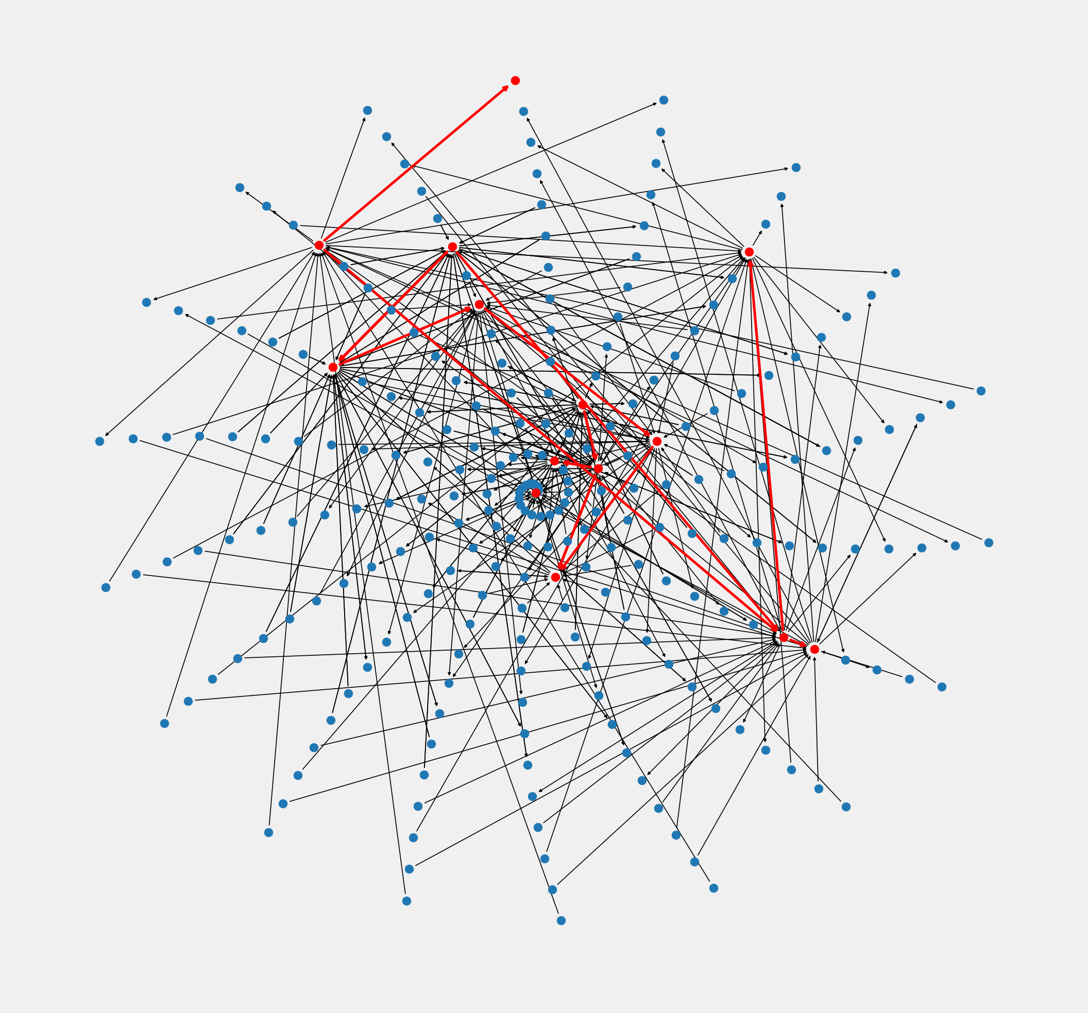
Testing – Hate Network Detection
Less friends and followers but we can go deeper (and it doesn’t take 3 hours):
Depth 3
Depth 4
Depth 10

Slide 23
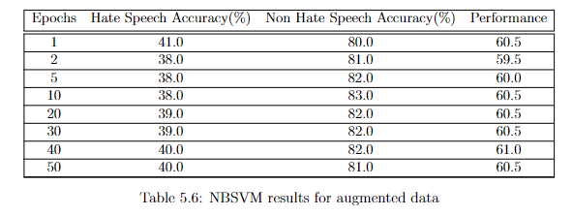
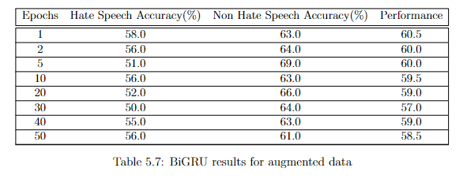
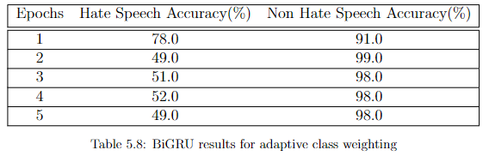
Failed Attempts
Data Augmentation: Attempted to change characters within the dataset to increase dataset size but contextual and position based data augmentation
Adaptive Class Weighting : Attempted to adapt class weight proportional to other classes’ accuracy but did not prove to be effective

Slide 24
Conclusion and Future Works
Overall, models with >80% accuracy with classifying both classes and hate speech networks were developed and a hate network detection system was developed proving that more than one person can be detected from singular pieces of hate speech.
However, more work can be done such as:
Make it multilingual
Make it work on other forms of social media
Working with more datasets
Let’s hope Twitter will actually do something with this!

Slide 25
Questions?

